Slide 1
APPRAISAL TRACKER
BY:
Sonam Nigam rit2012065
Angel Tiwari rit2012038
Akansha Gupta rit2012033

Slide 2
Abstract of project
This appraisal tracker system is used to track performance of individual which is rated by himself and superior of organization.
Performance rating is done based on behaviour, punctuality and obedience.

Slide 3
Specific Technologies
FRONT END
GUI (java)
BACK END
ORACLE

Slide 4
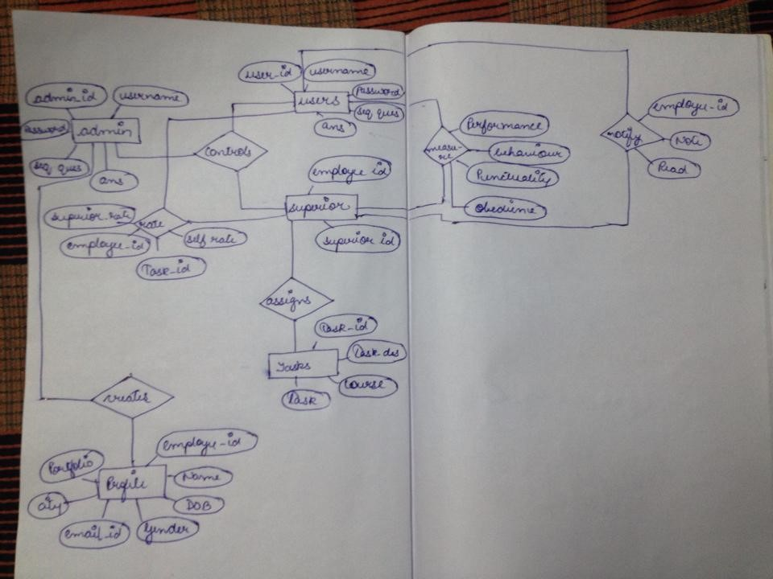
E R DIAGRAM

Slide 5
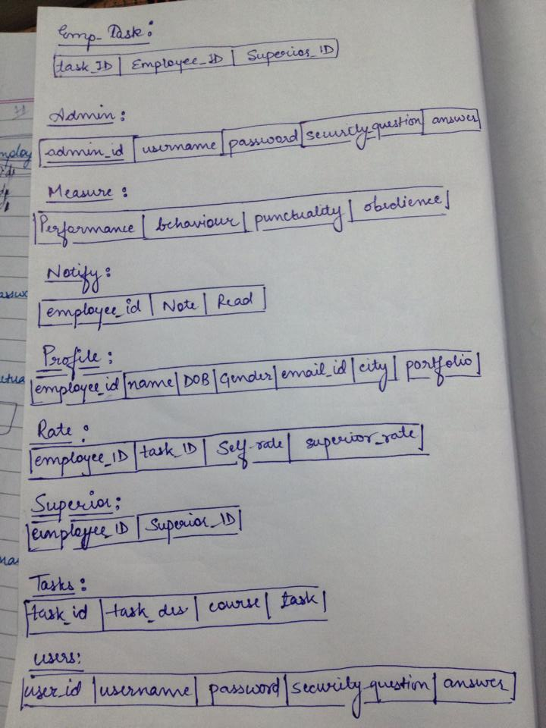
SCHEMA

Slide 6
Functional Components
ADMIN
Add or modify or delete new performance measures.
The system should allow administrator to control all the activities
SUPERIOR
The superior should be able to rate the individual working for him.
once a rating is done an automatic mail is sent to the individual about his rating
Individual rates himself.

Slide 7
CONNECTIVITY
Import JDBC drivers
Register JDBC drivers
Database URL formulations
Create connection objects

Slide 8
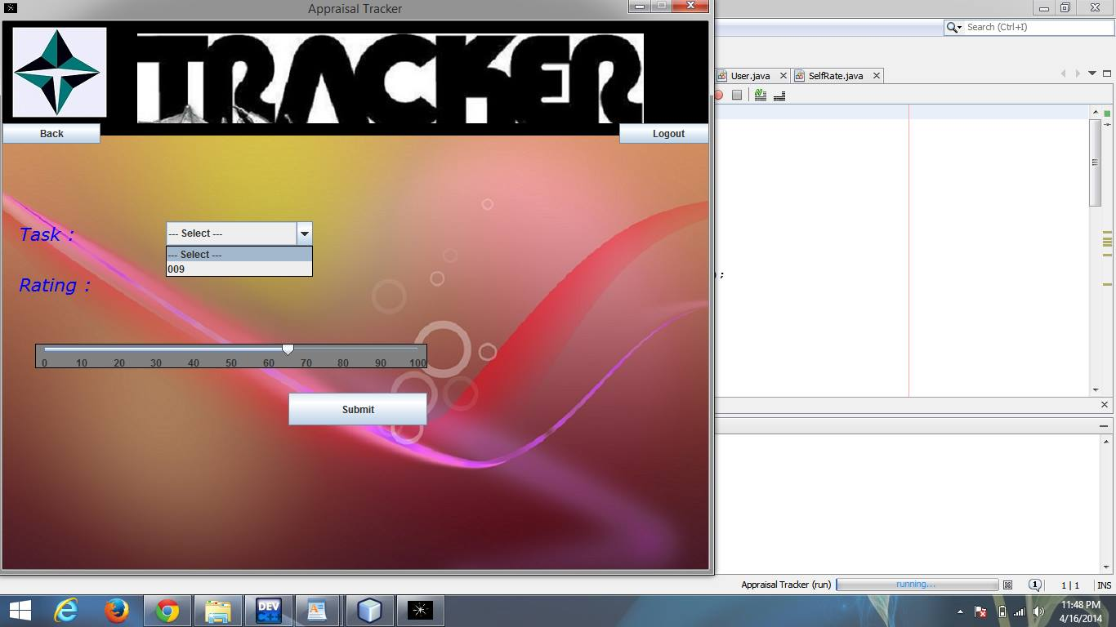
RATING

Slide 9
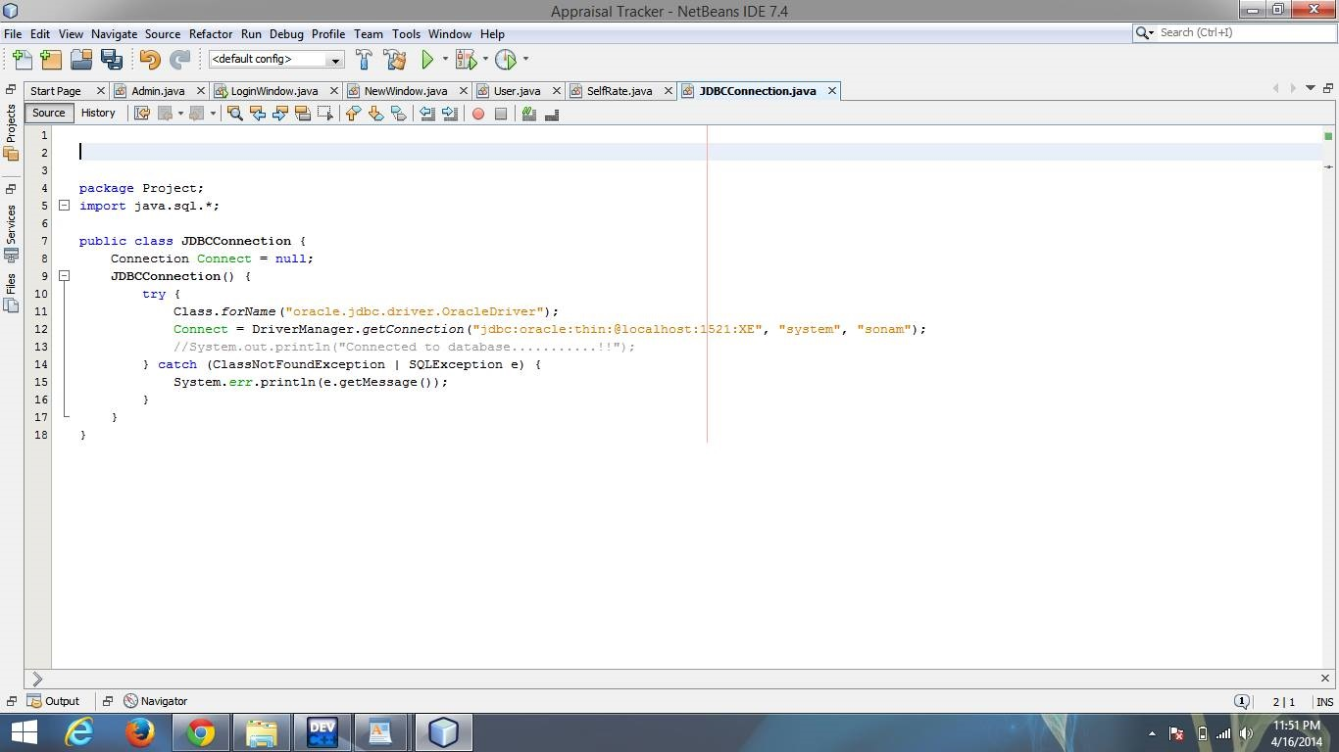
JDBC connection

Slide 10
THE END
THANK YOU

